Slide 1

Maize classification in Northern Ghana
Prepared by Prof Jianxi Huang, Prof Xuecao Li (CAU)
Presented by Dr Qingling Wu (UCL)
College of Land, China Agricultural University

Slide 2
The principle of classification

Slide 3
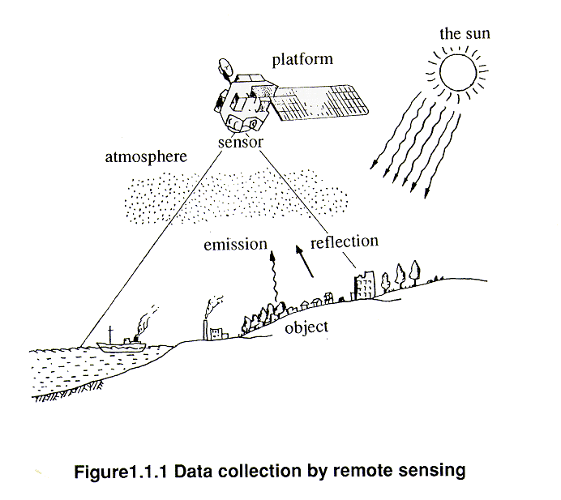
Principle of monitoring land cover by RS
Objects on the earth are continuously emitting, reflecting, and absorbing electromagnetic waves. The electromagnetic wave characteristic of different objects is diverse, people can distinguish them using these information.
Remote Sensing
Notes:
Remote sensing is the technique that obtains the electromagnetic waves and extracts information from them.
One common scenario is that the sun emits electromagnetic waves, then objects reflect them and finally these waves are picked up by sensors.

Slide 4
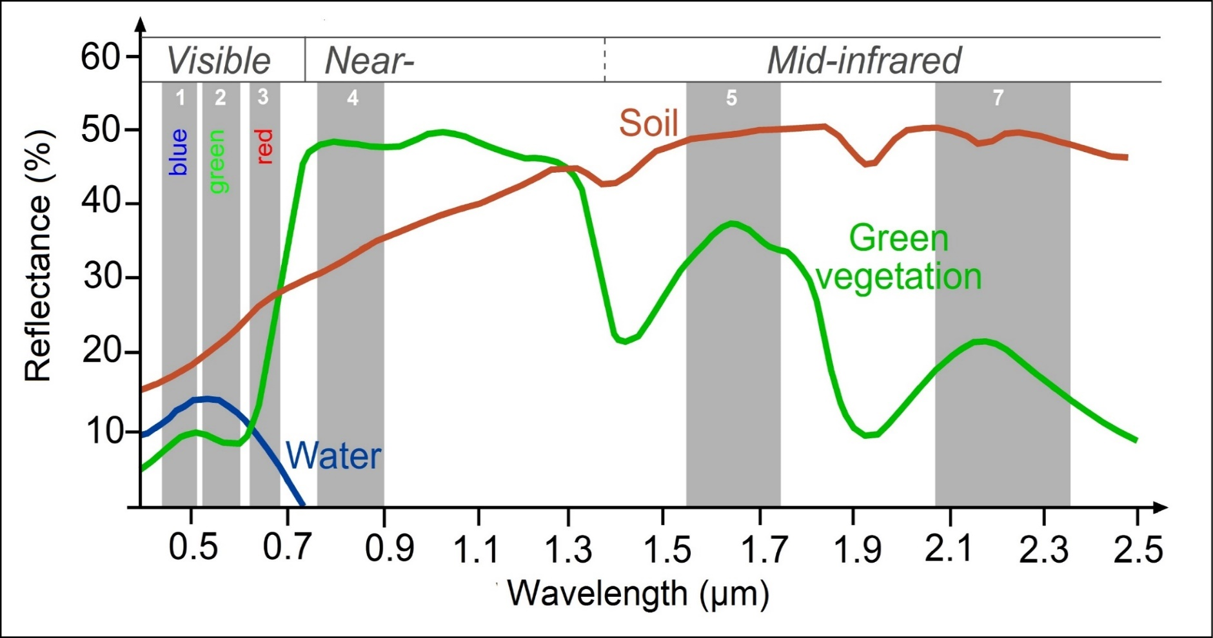
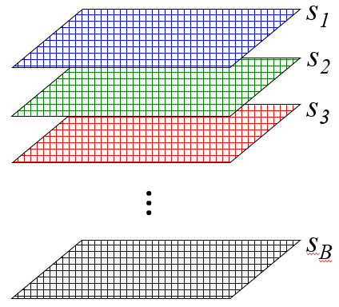
Reflectivity characteristics of different ground objects
Notes:
We listed the spectral curves of several ground objects. We can see, due to the different physical and chemical properties of each ground object, the spectral reflectivity waves are diverse.
For instance, due to the existence of chlorophyll, which can’t absorb the electromagnetic waves in the near infrared, so vegetation has a high reflectance in the near-infrared. While water can absorb the electromagnetic waves in the near infrared band very well, so the reflectance value is zero. These differences enable us to distinguish them.

Slide 5
Spectral bands for the Sentinel-2 sensors
Cloud, soil
Name | Formula
NDVI | (NIR – Red) / (NIR + Red)
LSWI | (NIR – SWIR1) / (NIR + SWIR1)
IRECI | (Edge3 – Red) / Edge1 / Edge2
EVI | 2.5 * ((NIR – Red) / (NIR + 6 * Red – 7.5 * Blue + 1))
GCVI | NIR / Green - 1
… | …
Notes:
This slide lists the original spectral bands for the sentinel-2 sensors. Sentinel-2 has 13 spectral bands. We can note that sentinel-2 has 4 red edge bands and the information of them can help us better obtain the situation of vegetation. Sentinel-2 revisits every five days, meaning we can acquire one image every five days at a given location.
In addition to the original band information, the combination of the bands can also be used to calculate the index. Through this procedure, we can eliminate part of the influence of clouds and soil, and highlight a certain aspect of the ground object. For instance, NDVI can highlight the growth information of vegetation and LSWI has the capability to delineate the water content information of ground objects.

Slide 6
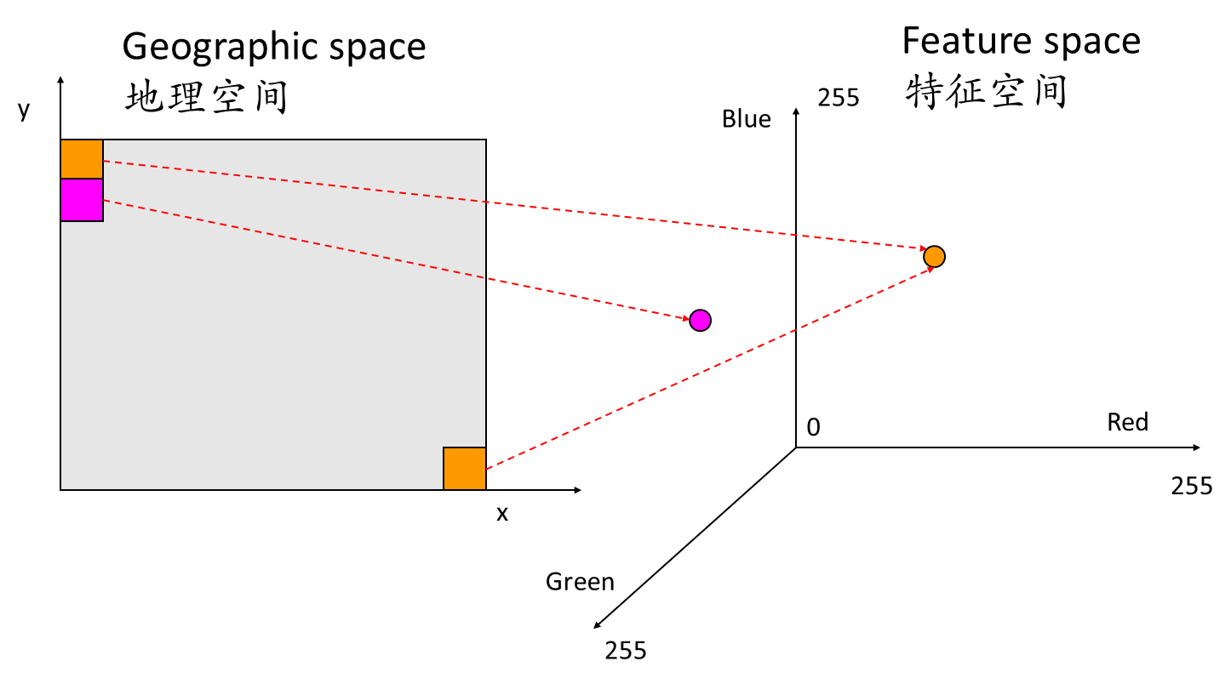
Spectral characteristics of multispectral remote sensing
The spectral albedo value of remote sensing (sensor) at different frequency bands
Notes:
Before introducing the specific classification method, we need to talk about the concept of feature space. Feature space is composed by multiple feature vectors. In the feature space constructed with remote sensing data, the original band and the calculated index can be regarded as feature vectors, and there can be multiple vectors. Two objects that are far in the geographic space may be close in the feature space.
在介绍具体的分类之前，首先需要引入特征空间的概念，特征空间是由多个特征向量组成的空间。我们所处的三维空间，可以将XYZ作为特征向量进行空间的构建。而在利用遥感数据构建的特征空间中，原始的波段以及计算的指数可以看作是特征向量，特征向量可以有多个。

Slide 7
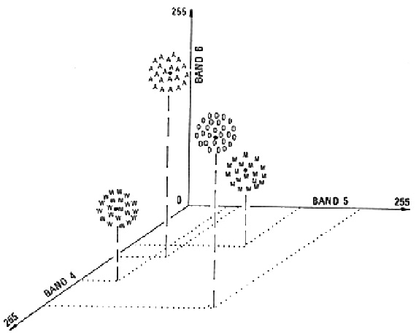
Classifier
K-Means
Classes in Spectral Space
Random Forest (RF)
Support vector machine (SVM)
Neural networks
…
Classifier training: to find the decision boundary to separate different classes
Notes:
In this slide, we can see, in the feature space, objects of the same type cluster together. Then, we can find the decision boundary by training classifier. The common classification methods include k-means, …
Next slide, we will introduce the random forest classifier in detail.

Slide 8
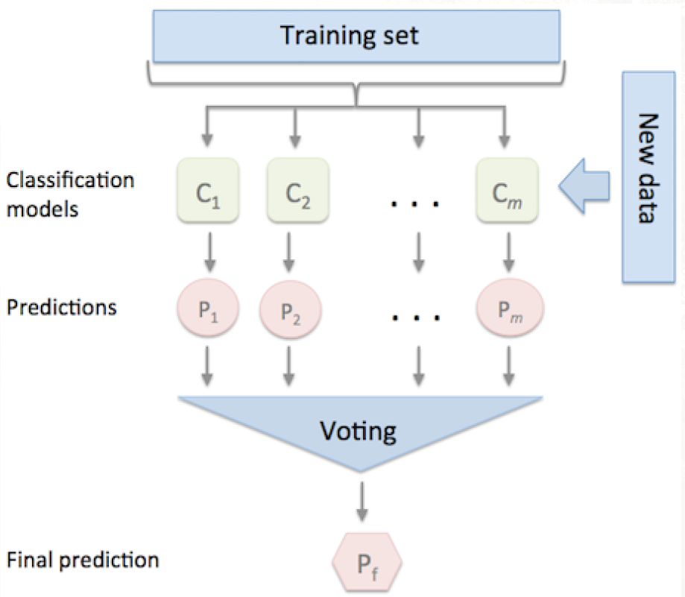
Random forest classifier
Random Forest Classifier:
A collection of CART (classification and regression trees) classifiers.
The voting method is adopted to solve the classification method.
Lots of
high-quality samples
+
Similarity
Notes:
Actually, random forest classifier is a collection of CART tree classifiers. Every CART tree classifier will random select samples and features. After the training procedure, the voting method is adopted to solve the classification method. That is to say, if most classifiers choose this place is maize, eventually the output result is maize.
Note: as a supervised classification method, random forest requires a large number of high-quality samples to obtain good classification results.
Of course, the characteristics of ground objects will also affect the classification results. If the differences within the same ground objects are small and the differences between diverse ground objects are large, we will get a good result. On the contrary, we can also take an example, for the classification of maize, the main influence factors are phenology and growth trend. In southwest China, the sowing period of maize is from February to May, during which maize can be sown, resulting in a large difference, and it is difficult to obtain good classification results.

Slide 9
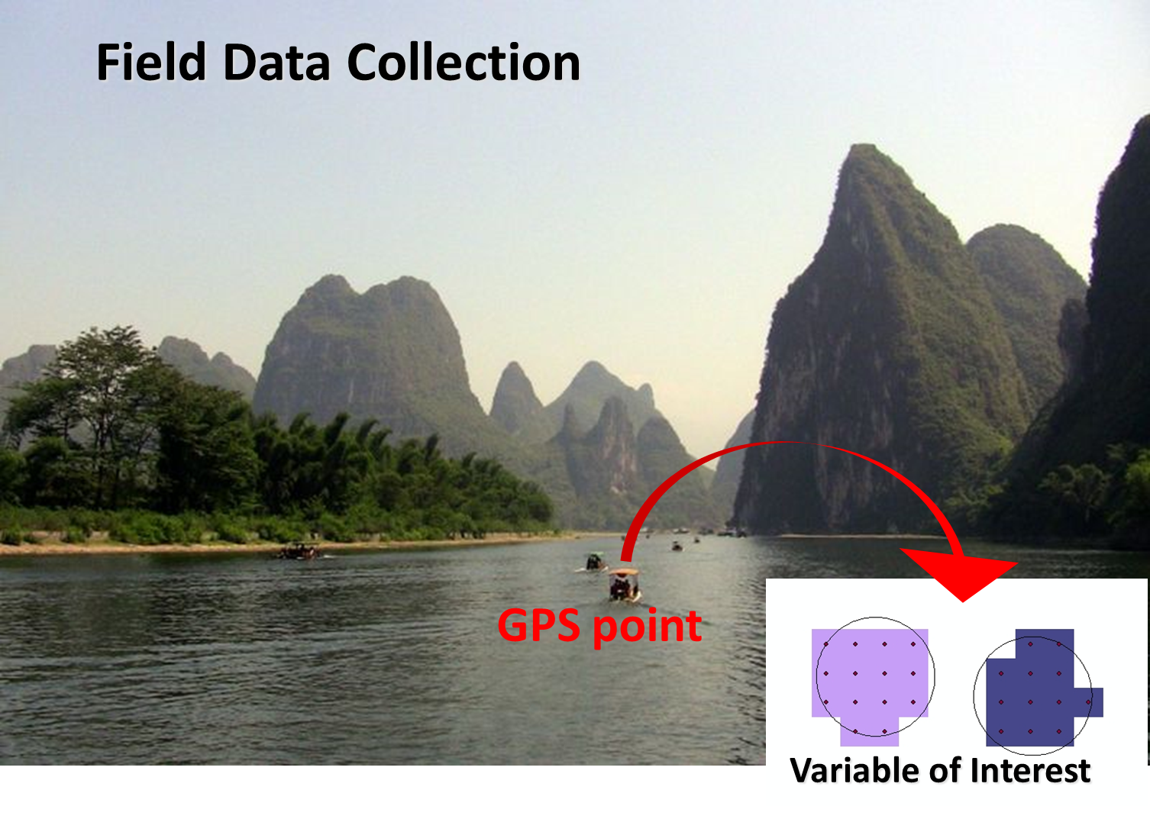
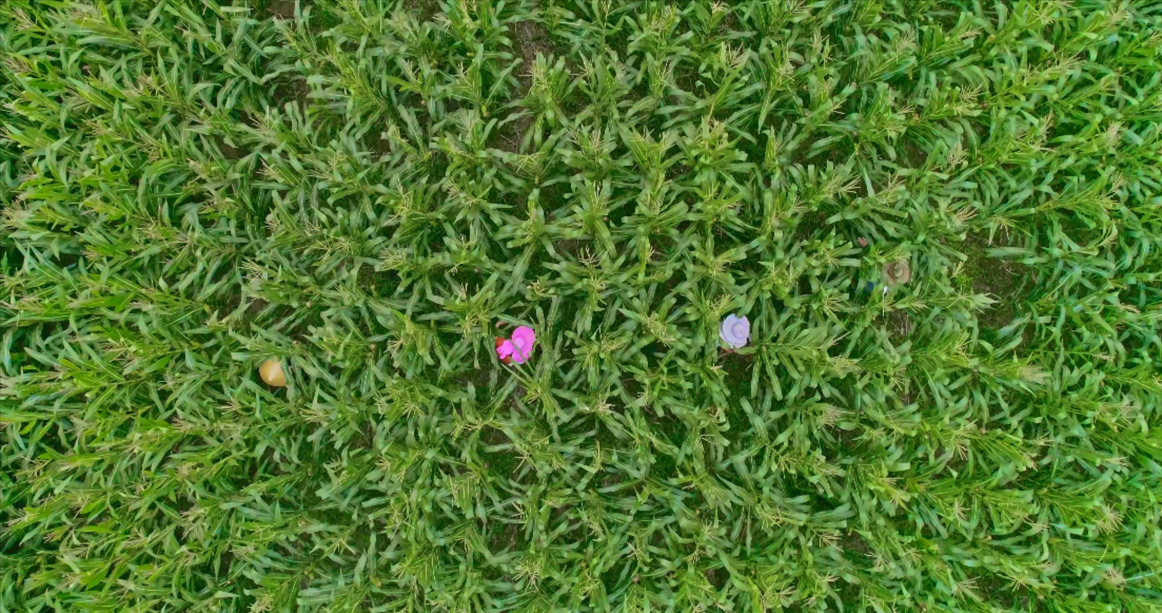
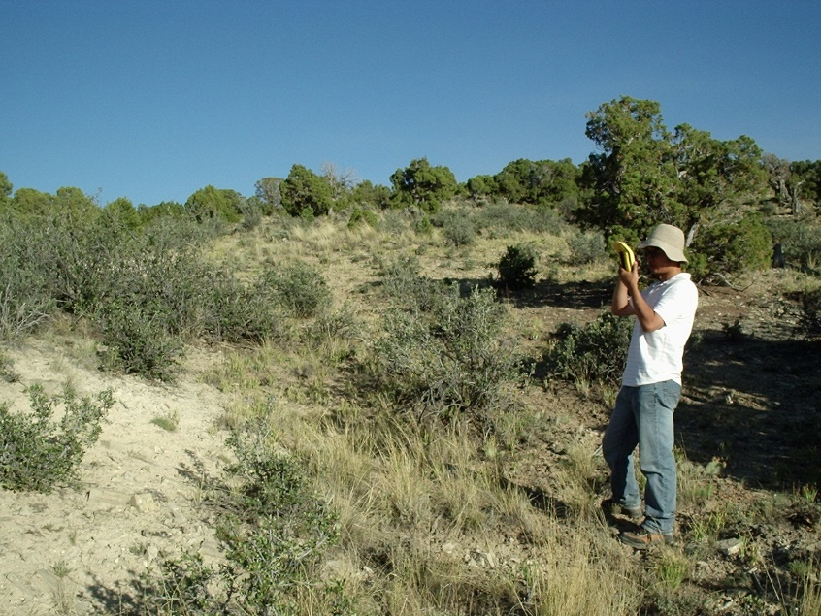
Collect sample data (field experiment)
Location
+
Label
Notes:
我们通常通过田间实验来收集样本，主要需要获取的位置以及对应的地物类型。我们一般通过GPS设备来获取位置，在获取位置的时候，尽量选择离地物边界较远的地方。在获取玉米地的位置时需要到达地块中央或者勾勒出整个地块的形状。
We usually collect samples through field experiments and we mainly need to obtain the location and the type of ground object. The GPS equipment can help us to get the location. When getting the position, we need to choose a place far from the boundary. More than 10meters or in the middle.

Slide 10
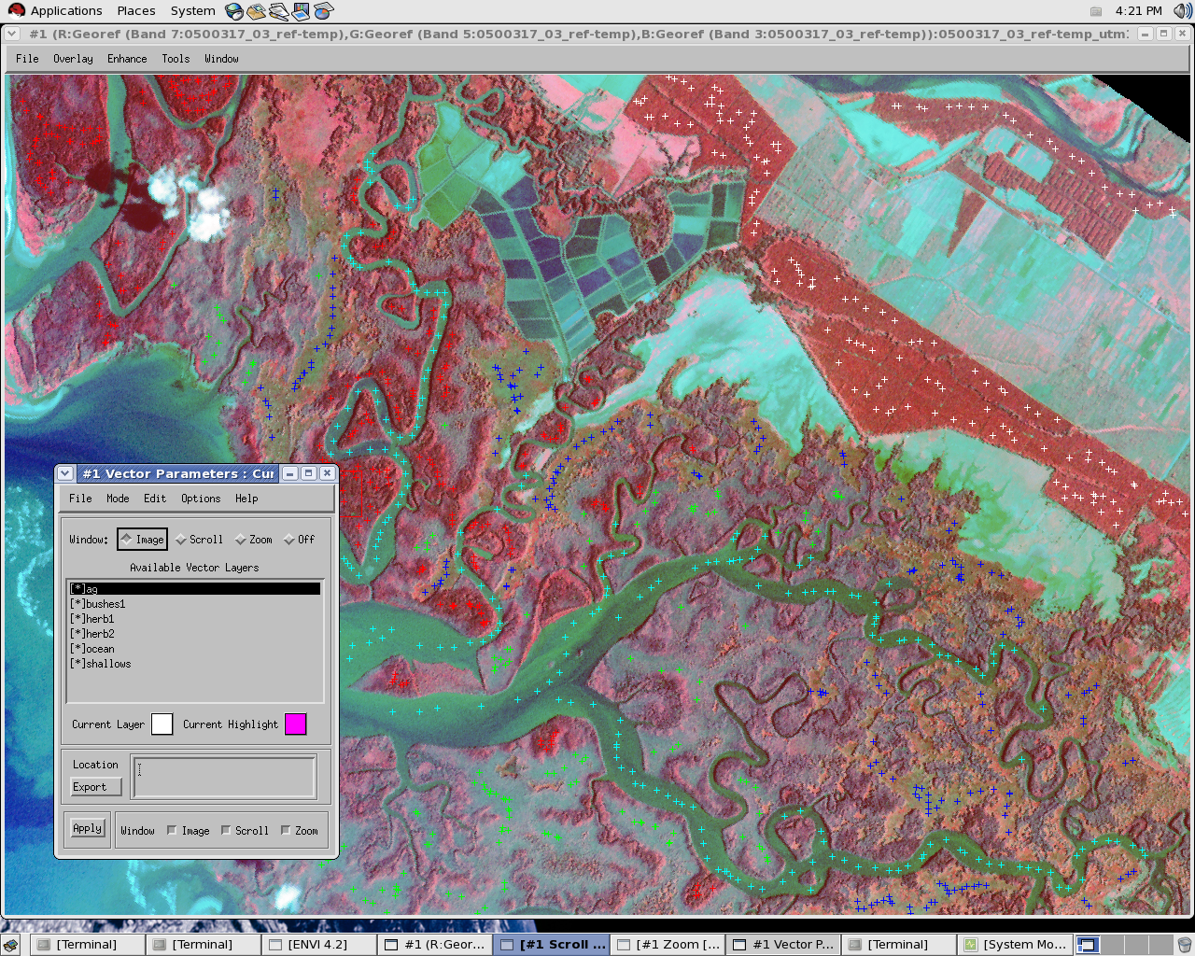
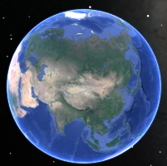
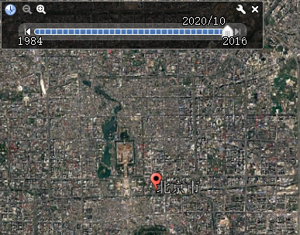
Sample data collection (human interpretation)
Notes:
我们还可以通过目视解译来获取样本数据，通常是通过高分辨率的Google Earth影像等来进行样本的解译。这种方式对于解译人员的要求较高，需要注意解译样本的质量。
We can also obtain sample data through human interpretation, usually with the help of high-resolution Google Earth images. In the false color image, the red one is vegetation, the blue and green one is the water body. But this method has a high requirement for the interpreter, and it is necessary to pay attention to the quality of the interpretation samples.

Slide 11
Case of maize classification in Ghana

Slide 12
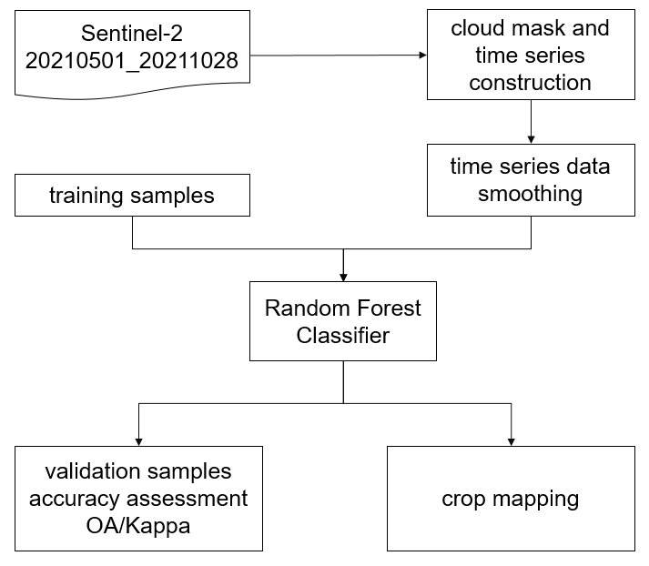
Framework
Original band | Index
Red Edge 1 | NDVI
NIR | LSWI
SWIR 1 | IRECI
SWIR 2 | GCVI
(number of trees:100)
Code:
https://code.earthengine.google.com/4795796bb1f47ff7e9ca9c0aae263c11
Notes:
This is the framework of the classification method, First, we obtain Sentinel-2 images from May to October. After cloud mask, the generated time series images are smoothed. Then, we input samples for the training of random forest classifier. The selected features are listed in this table, including the original band and the constructed index. After the model training, we can carry out the procedure of model accuracy evaluation and crop mapping.

Slide 13
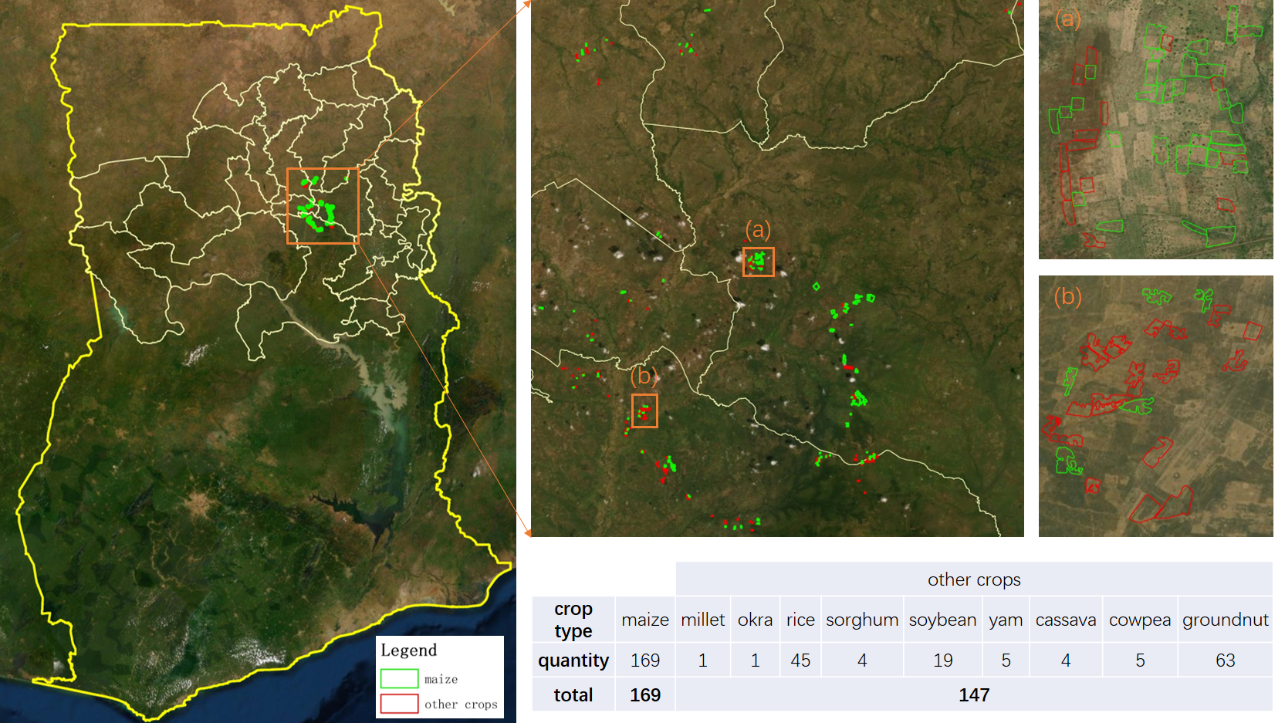
Distribution of samples
Notes:
This slide shows the distribution of cop samples. The samples are mainly concentrated in the middle part of the study area. We divided all samples as maize and non-maize. The border of maize fields is colored as green and that of non-maize is colored as red.

Slide 14
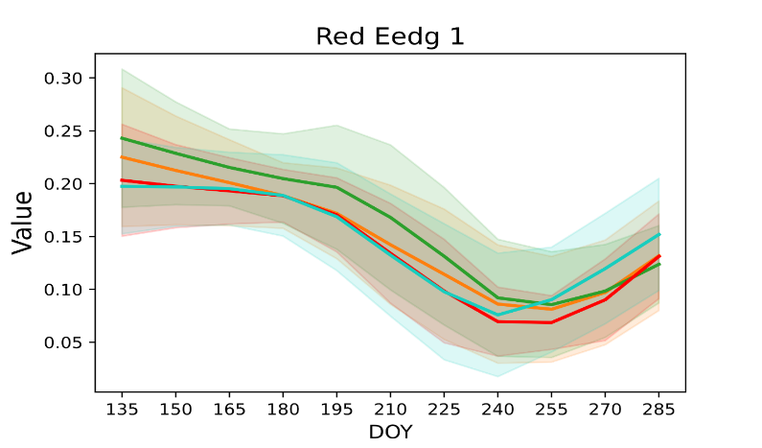
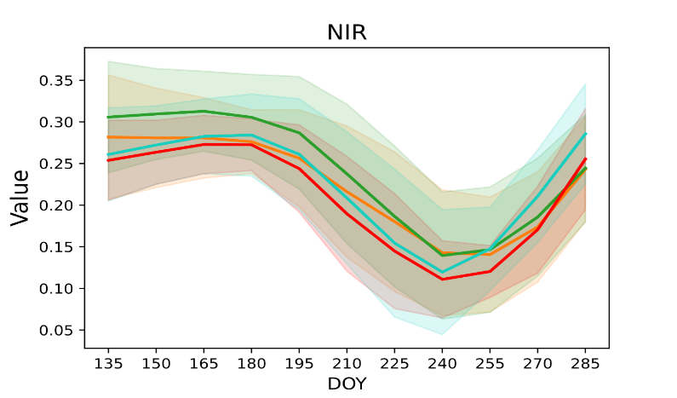
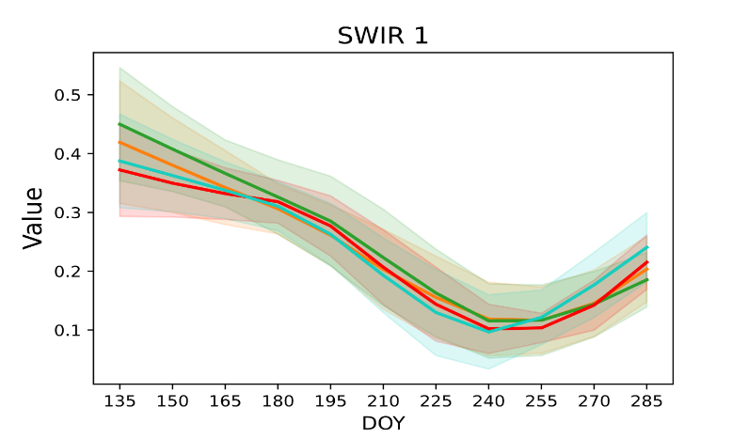
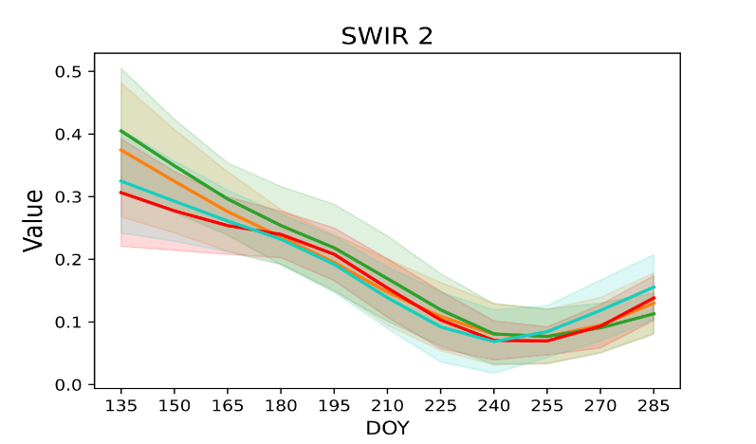
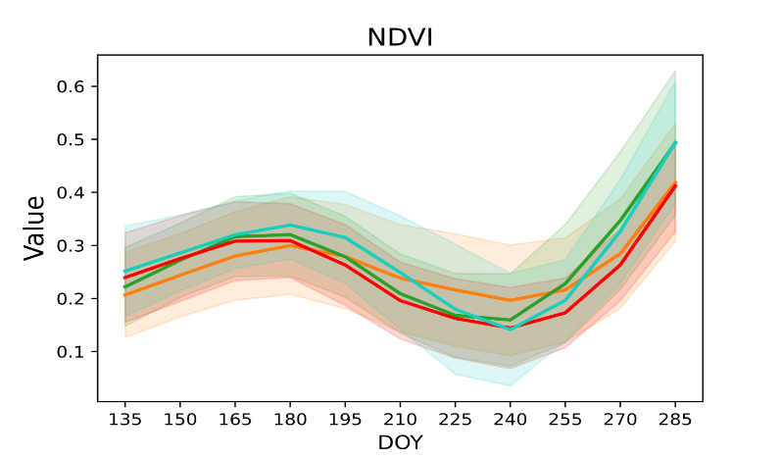
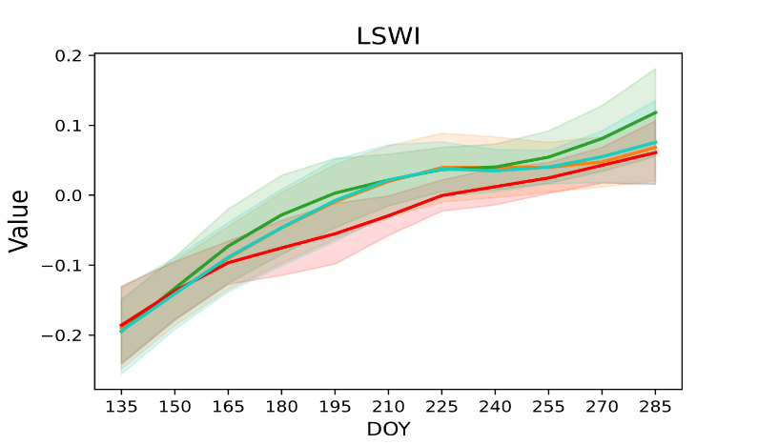
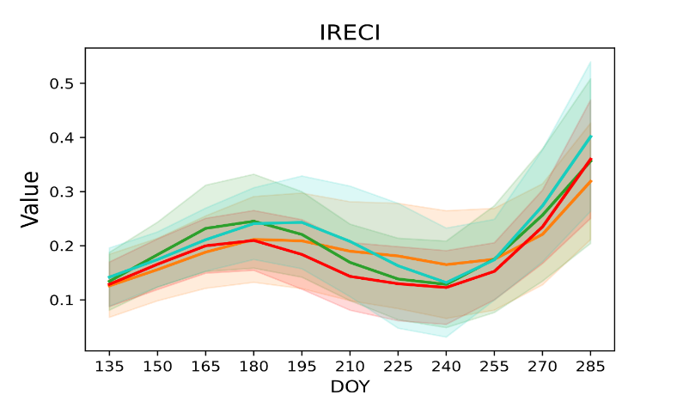
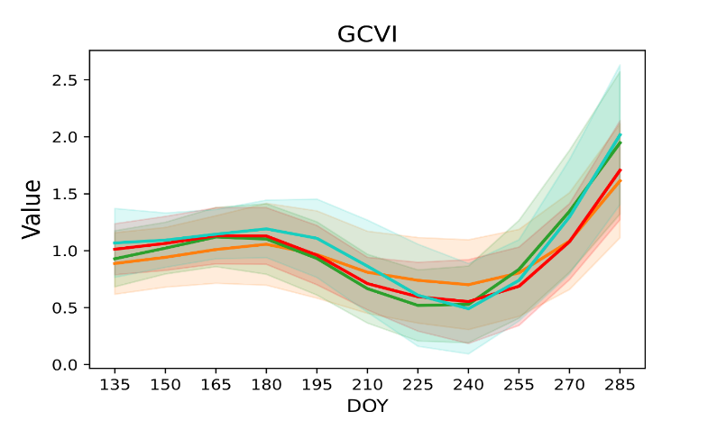
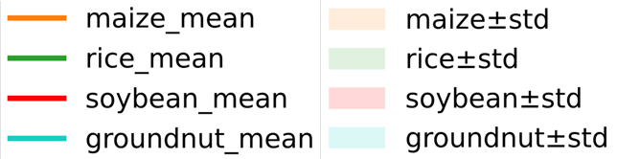
Spectral curves of crop samples
Notes:
This figure shows the spectral curves of maize, rice, soybean, and peanut. We can see, the trends of these crops are similar, but we can also note some differences. For example, rice has a higher value in red edge and NIR band than other crops. And soybean has a lower LSWI value than others. So we can still differentiate them by these characteristics.

Slide 15
Accuracy assessment
training set: 70% samples, validation set: 30% samples
Classification result: https://code.earthengine.google.com/?asset=users/xianda19/classification_result/2021/Ghana/maize_20210501_20211028_70percentSamples
Crop | others | maize | Users accu. | Overall accu. | Kappa score
others | 7823 | 1234 | 0.86 | 0.84 | 0.68
maize | 1800 | 7975 | 0.82
Producers accu. | 0.81 | 0.87
training set: 100% samples
Classification result:
https://code.earthengine.google.com/?asset=users/xianda19/classification_result/2021/Ghana/maize_20210501_20211028_100percentSamples
Notes:
We randomly divided these collected samples in Ghana into training and validation sets, of which 70% were used as training samples, and 30% were used as validation samples. It can be seen that the overall accuracy is 0.84 and the Kappa coefficient is 0.68, suggesting a relatively good performance. We also generated a result using all samples to train random forest model.

Slide 16
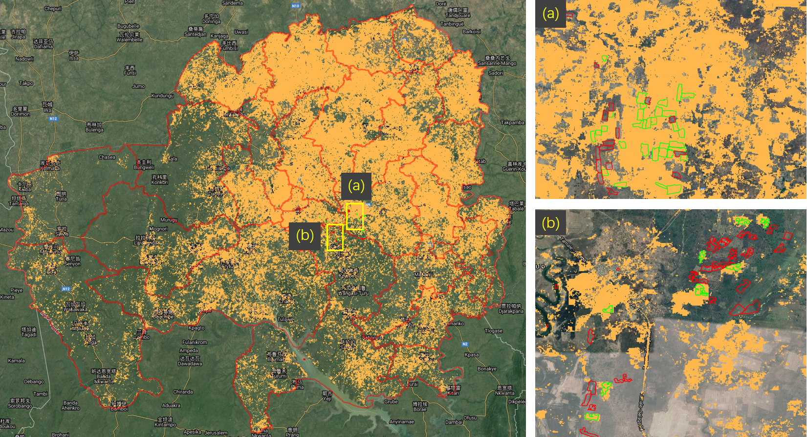
Classification result of maize
Resolution:
10m
Notes:
This slide is the classification result of maize, polygons colored green are maize and that colored red are non-maize.
From the figure a and figure b, we can see, most of the samples are classified correctly.

Slide 17
Thank You

